Slide 1
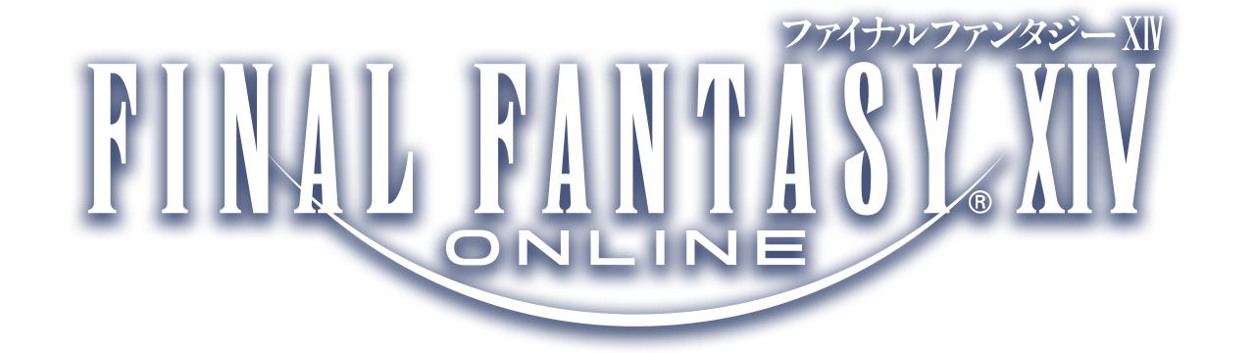
LHL – CAPSTONE FFXIV Consumables Market Analysis
By Theo Plessas

Slide 2
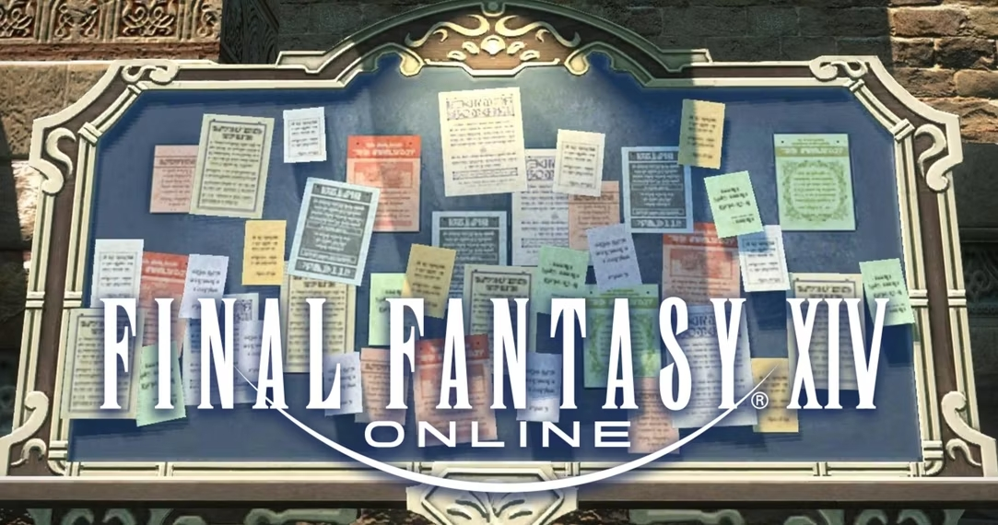
What is the Market Board?
Central hub for Players to buy and sell items from other Players
Pricing is fully Player-Driven
Market-Trends and Fluctuations exist
Hard to predict since Player needs are evolving
Different Players fill different supplier roles
Raw material
Intermediate ingredient
Crafted item

Slide 3





Why Consumables?
Used in challenging content to enhance Player power
Players organize themselves weekly for this content
It’s the part of the market I participate the most in
Notes:
Players purchase consumables from the market board to save themselves the trouble of crafting which is time consuming
Difficult content is restricted to 1 completion per week so I expected to see restocking behavior on reset days
I mainly spend my time in game crafting these items for because I like the minigame that is the market board

Slide 4
The Goals !
To identify any market patterns in 5 high-end items to maximize my profits
Which days during the week are most Players buying these 5 items?
Can I build a predictive model for these items?

Slide 5


Tools & API
Universalis – Universalis is a market board data site with crowd sourced information
XIVAPI – Provides a massive amount of FINAL FANTASY XIV game data in a JSON format via a REST API

Slide 6
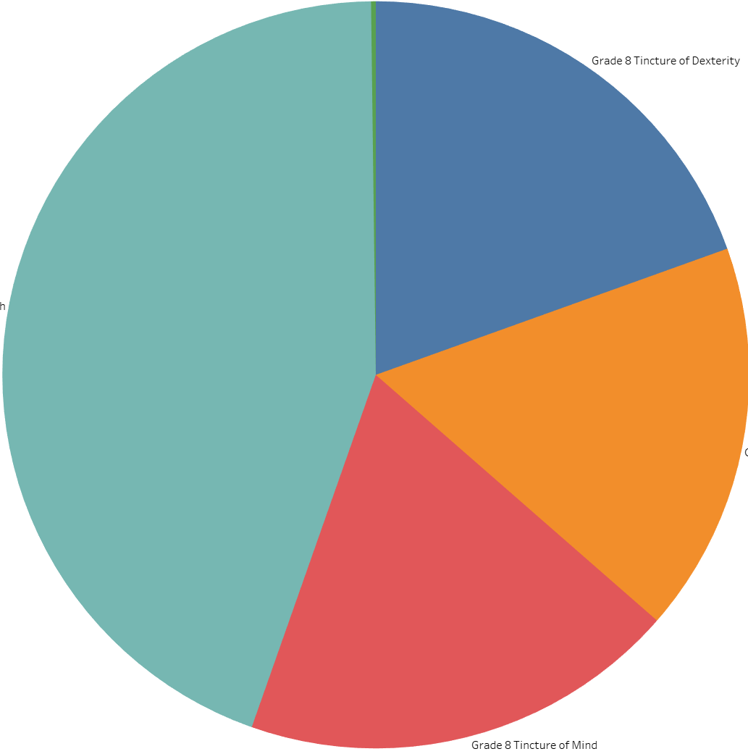
The Data
53 weeks of Data
We are looking at 5 different potions – They all effect different Player stats
Strength - 173300 Transactions
1 outlier
Dexterity – 74692 Transactions
1473 outliers
Mind – 73726 Transactions
282 outliers
Intelligence – 64938 Transactions
1063 outliers
Vitality – 770 Transactions
25 outliers
Notes:
Outliers were identified using the z score method

Slide 7
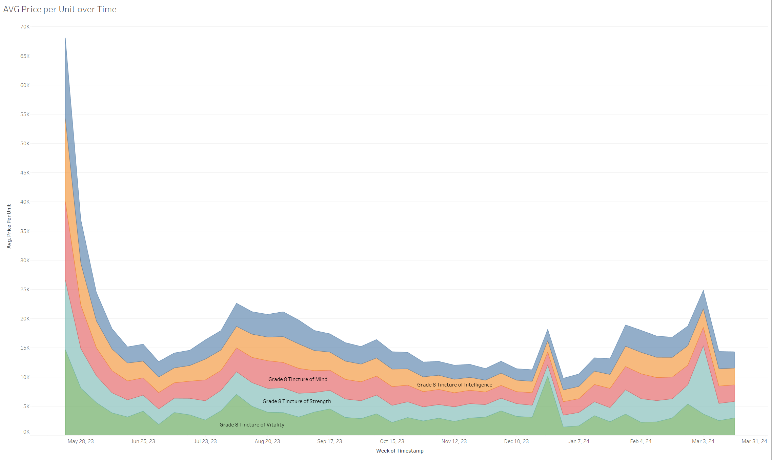
Avg Price per unit by Month
Strength
Dexterity
Mind
Intelligence
Vitality
Notes:
June 20th patch
July 18th patch
August 8th patch and fan fest las vegas
October 3rd patch
X mas/new years In-game event
Fanfest Japan new expansion full trailer new content announcement
Xbox beta

Slide 8
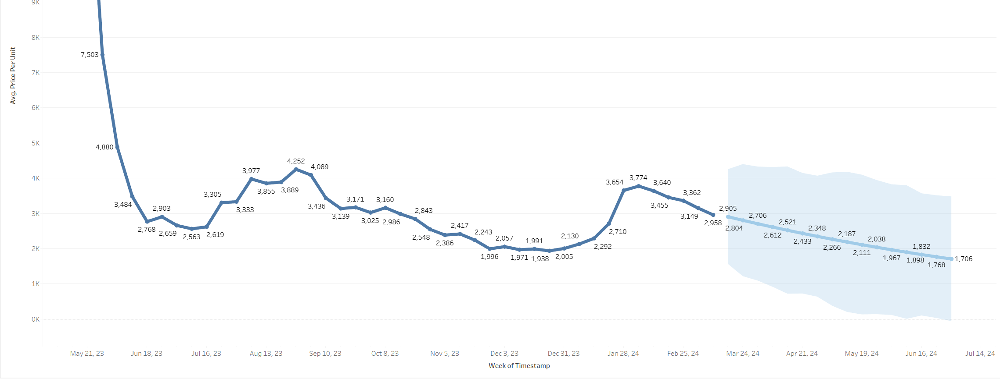
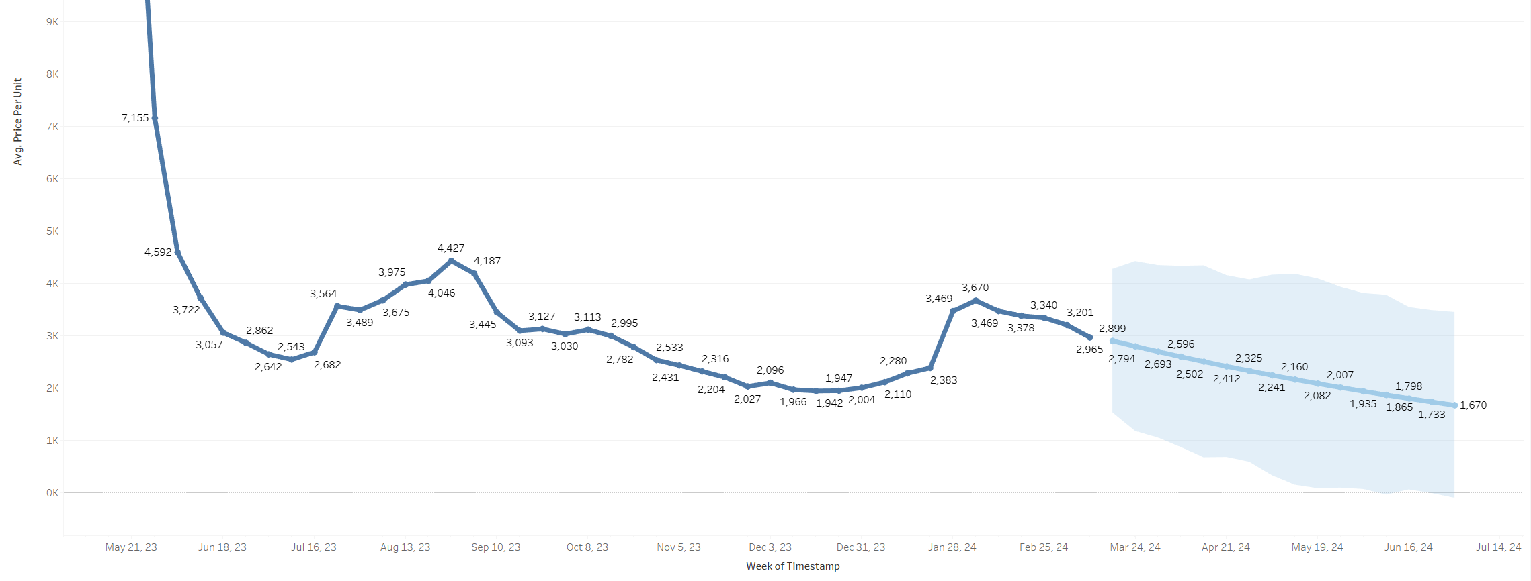
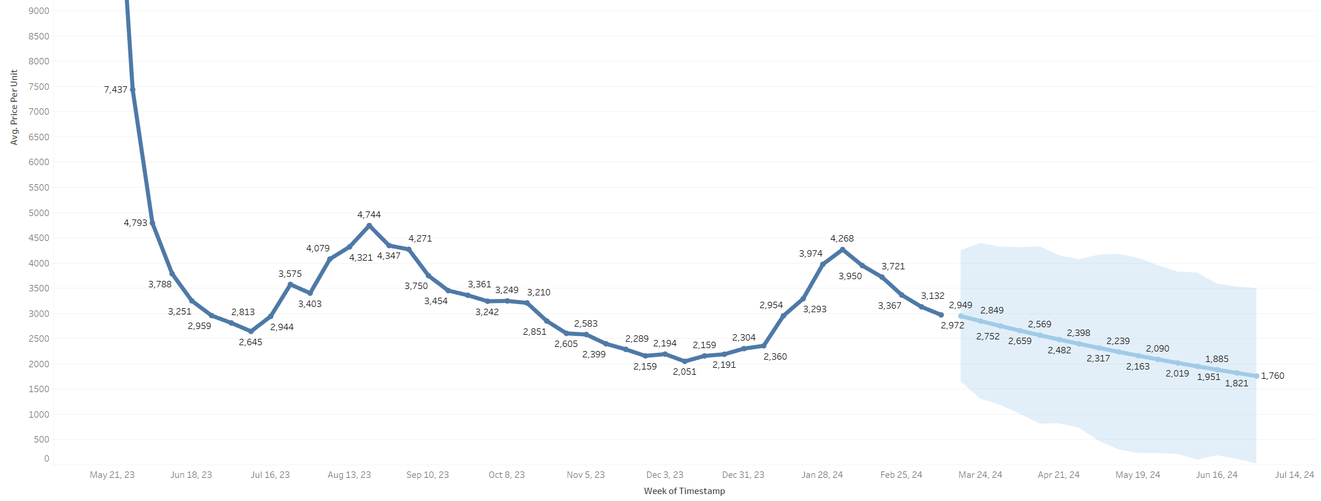
Forecasting
Dexterity
OLS Regression models
Intelligence
Mind
Notes:
Similar transaction volume similar shapes
Timeseries problems
Linear regression is not optimal for market trends
That’s why it only goes down

Slide 9
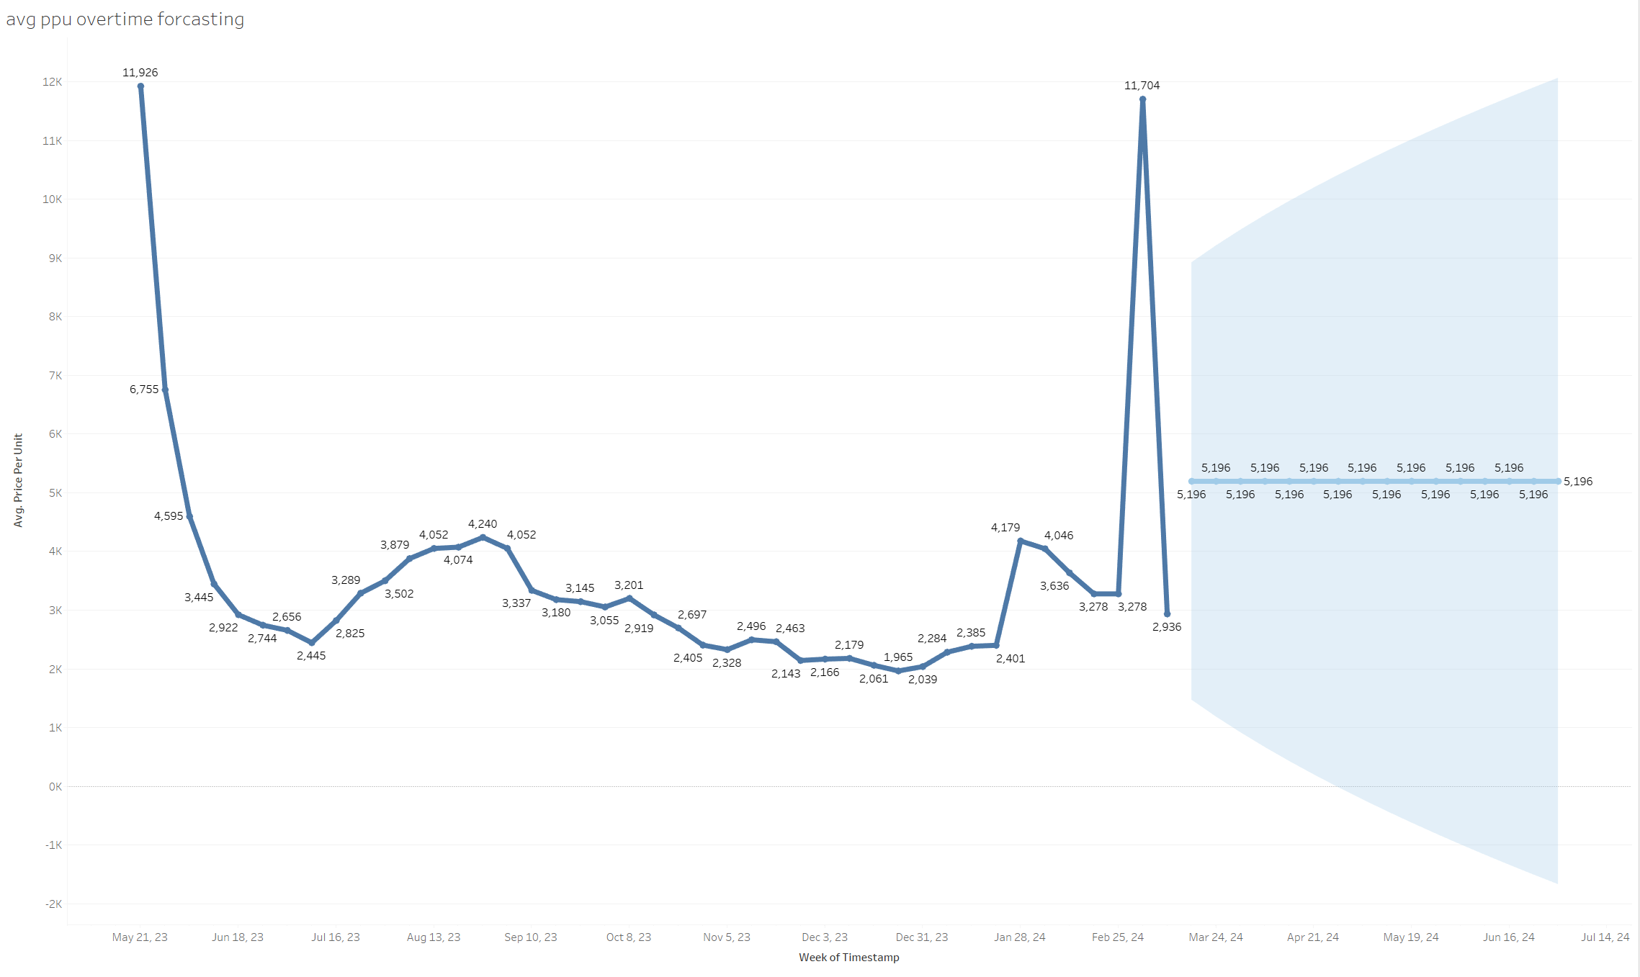
Forecasting-Strength
Notes:
l;inear regression is not optimal for market predictions
Confidence interval is represented by shaded area
Large spikes are still within outlier ranges I set

Slide 10
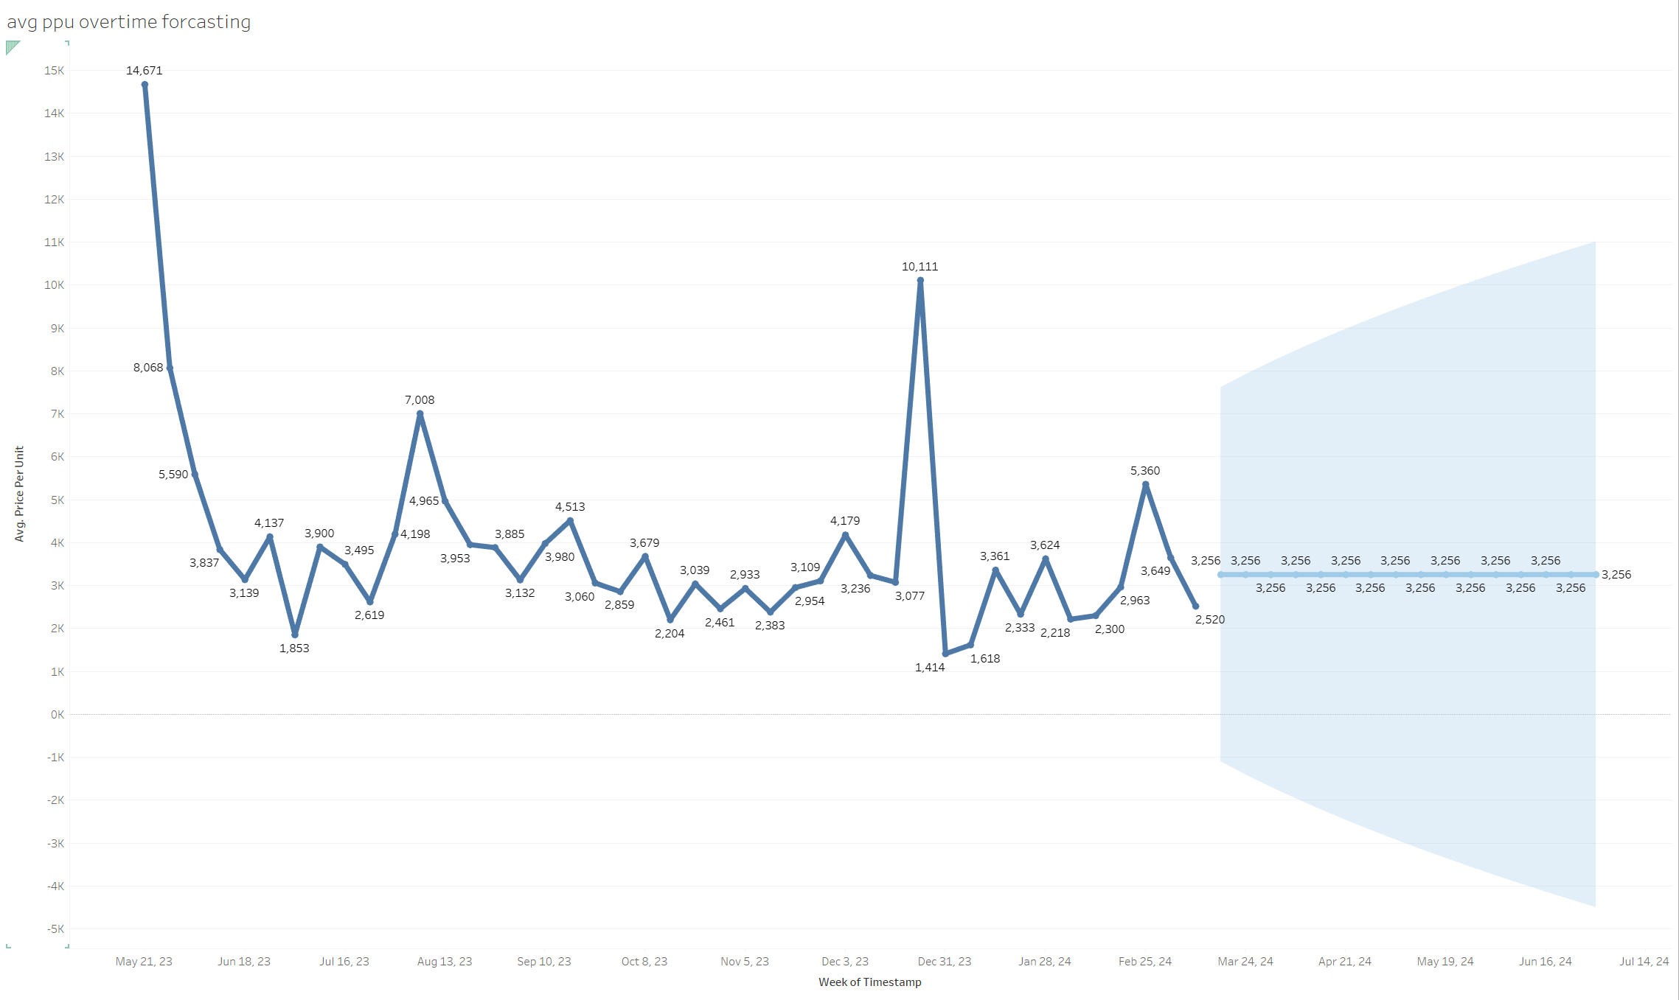
Forecasting-Vitality
Notes:
To improve these models for next time I learned that because they are kind of time series problem
Mean absolute error
MAE would have given me deeper insight into the forecast of these markets

Slide 11
The Results ?
I was able to identify Content patches
Everyday
Yes
Notes:
To identify any market patterns in 5 high-end items to maximize my profits
Content patches were an unexpected insight
Which days during the week are most Players buying these 5 items?
- no single day during the week stood out more than the others
Can I build a predictive model for these items?
To predict the general trend over weeks at a time

Slide 12
Thank you!

